Slide 1
Real-Time Sketch-Based Adaptive DDoS Detection for ISP Network 2021 Security & Communication Networks no citations
Rohullah Jahanafrooz
1401/10/13

Slide 2
Problem
Challenge: Machine Learning model updating are time consuming
Goal: adaptive resource efficient DDoS detection

Slide 3
RT-SAD in brief
Backbone-base (because it is a sample of high-speed network) traffic aggregation and detection

Slide 4
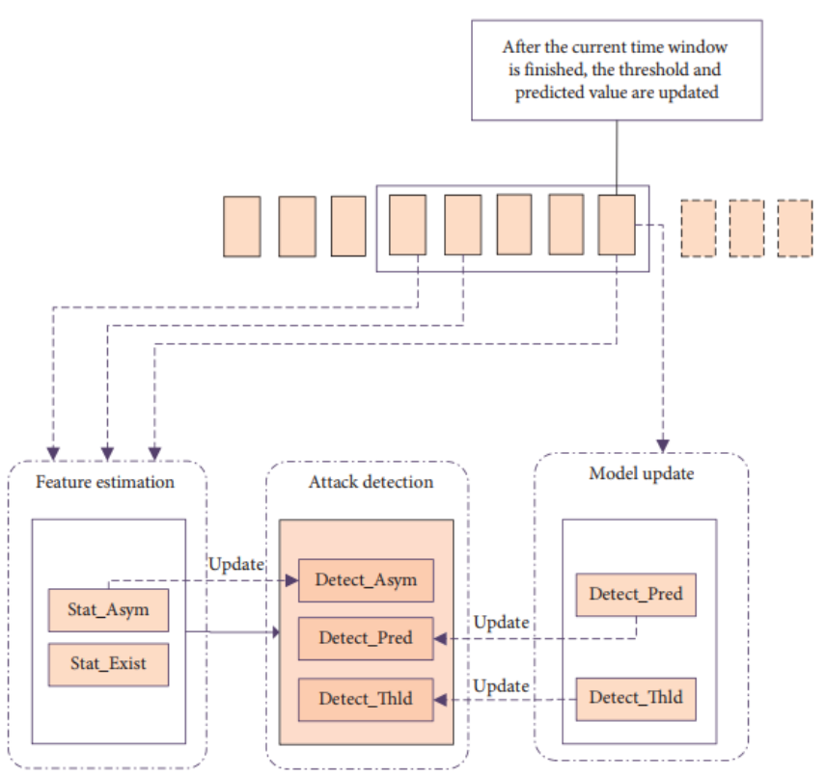
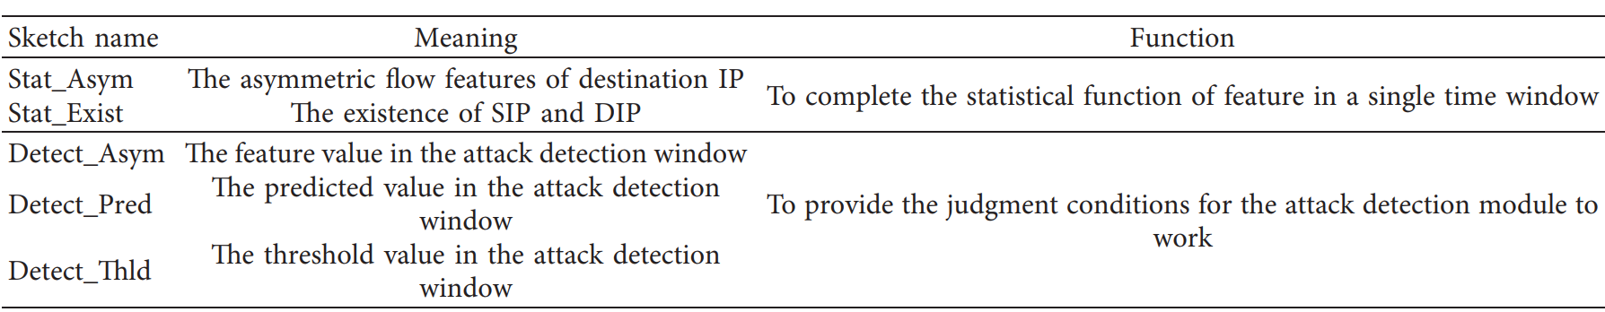
Architecture
Four sketches
Modules

Slide 5
Workflow - algorithm
Key idea: significant change in asymmetric value for a victim ip’s single feature (DIP) in a time window.
Flow(srcIP,dstIP) aggregation in each time window
Detection: threshold on a feature, that has asymmetric value for destIP(DIP). DIP is victim IP
Feature of DIP: current window value, predicated value, threshold calculated based on previous time windows.
At the end of window Updates only normal IP’s predictive and threshold values ( so the all three tables in Attack detection module are constantly updating)

Slide 6
Workflow
Arriving flow record
Sketch_exist(sip,dip)++
Sip Dip
Sketch_exist(dip,sip)++

Slide 7
Evaluation
Testbed architecture:
Datasets: captured attack traffic generated by Stress tool.
Criteria:
Detection latency and accuracy
Sketch table size

Slide 8
Relation
Which component of our architecture? Sketch, analyzer
Which problem it solve? Attack detection based on previous samples
Why to use it? Simple and low resource usage
Draw it in picture:

